Slide 1
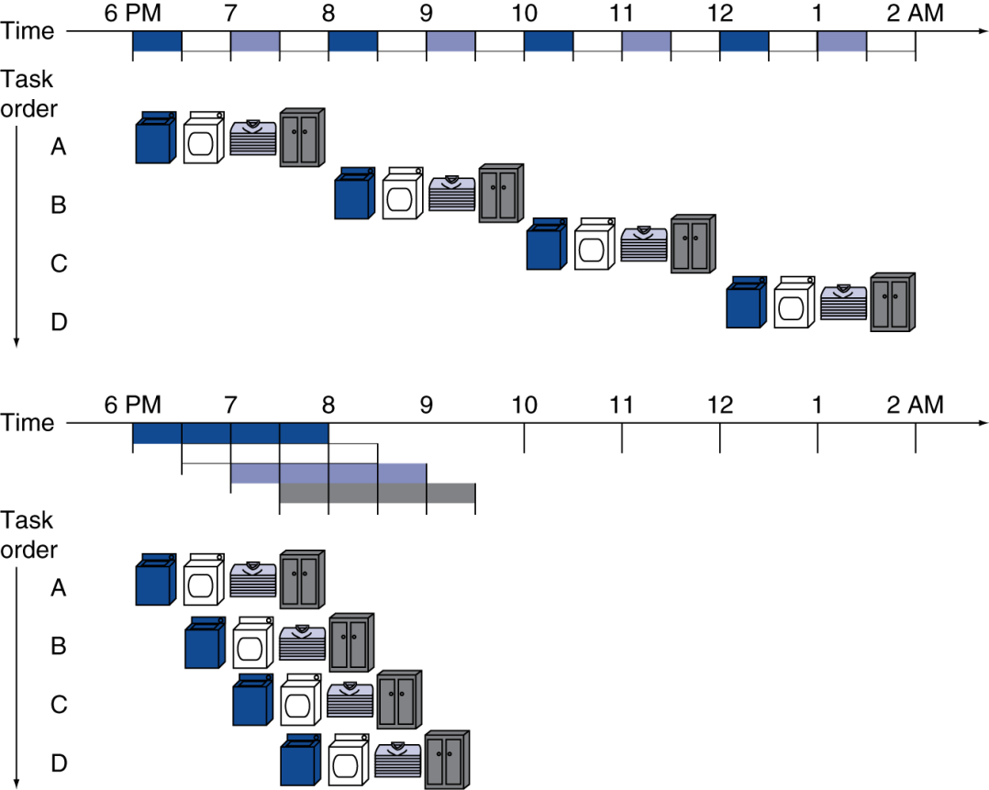
Single cycle instructions vs pipelined
Pipelined laundry: overlapping execution → 4 tasks: Wash, Dry, Fold, Put away
Parallelism improves performance
One at a time
Throughput = loads * stages * time = 4 x 4 x .5 = 4 loads per 8 hrs
Non-stop
Speedup = (loads + (stages - 1)) * time = ( 4 + ( 4 - 1)) * .5 = 4 loads per 3.5 hrs

Slide 2
Pipeline
We can consider instruction execution as a 5-part task
IF: Fetch instruction from instruction memory
ID: Instruction decode & register read
EX: Execute operation or calculate address
CBZ/CBNZ use ALU (to subtract) and then update PC
ALU operations are completed in this task
LDUR/STUR Memory address is computed in this stage
Data Access: Access memory operand
LDUR read data from memory
STUR store data into memory
Other instructions do not do anything in this task
WB: Write result back to register
Not used by branch/conditional branch and STUR
write result into destination Register – LDUR, ADD, SUB, ORR, AND

Slide 3
Pipeline Design
We have several instructions going through our datapaths simultaneously.
In each cycle:
1. a new instruction is being fetched
2. an instruction which (already fetched) is decoded and register values are read
3. an instruction which (input registers are already read) may be using ALU either to perform arithmetic operation for R-type or to add (R_{base})+offset to obtain address for Load/Store
4. an instruction which (address already computed) may be accessing memory for load or store instructions (otherwise no action in this stage)
5. an instruction which (completed ALU or Load operation) is attempting to store results in R_{d}
We need to keep track of all these (5) instructions in our datapaths
The control paths also need to make sure that the control signals relate to correct instructions

Slide 4
Pipeline Performance
Assume time for different tasks are
100ps for register read or write
200ps for other tasks (ignore control and mux delays)
Compare pipelined datapath with single-cycle datapath
Instr | Instr fetch | Register read | ALU op | Memory access | Register write | Total time
LDUR | 200ps | 100 ps | 200ps | 200ps | 100 ps | 800ps
STUR | 200ps | 100 ps | 200ps | 200ps |  | 700ps
R-format | 200ps | 100 ps | 200ps |  | 100 ps | 600ps
CBZ | 200ps | 100 ps | 200ps |  |  | 500ps
We need to use a clock that allows the slowest operation to complete

Slide 5
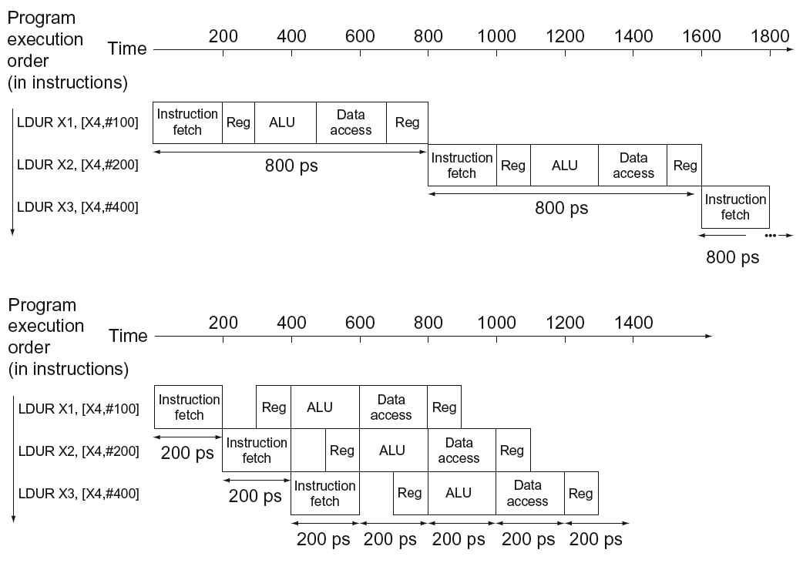
Pipeline Performance
Single-cycle (T_{c}= 800ps)
Cycle time = time for longest instruction = 800ps
100ps wasted
Pipelined (T_{c}= 200ps)
Cycle time = slowest pipeline stage
= 200ps
Speedup = 800/200 ~ 4

Slide 6
Single cycle instructions vs pipelined
Pipelined laundry: overlapping execution → 4 tasks: Wash, Dry, Fold, Put away
Parallelism improves performance
One after another
Throughput = loads * stages * time = 10K x 4 x .5 = 20K = 10K loads per 20K hrs
Non-stop
Speedup = (loads + (stages - 1)) * time = (10K+ ( 4 - 1)) x .5 = 10.003K loads per 5001.5 hrs

Slide 7
Pipeline Performance
Let us consider how instructions flow through a pipeline
1: ADRP X0, v
2: ADD X0, X0, :lo12:v
3: LDUR X1, [X0, #0]
4: LDUR X2, [X0, #8]
5: ADD X1, X1, X2
6: LDUR X2, [X0, #16]
7: ADD X1, X1, X2
CYCLE | 1 | 2 | 3 | 4 | 5 | 6 | 7 | 8 | 9 | 10 | 11 | 12
ADRP X0, v | IF | ID | EX |  | WB
ADD X0, X0, :lo12:v |  | IF | ID | EX |  | WB
LDUR X1, [X0, #0] |  |  | IF | ID | EX | MEM | WB
LDUR X2, [X0, #8] |  |  |  | IF | ID | EX | MEM | WB
ADD X1, X1,X2 |  |  |  |  | IF | ID | EX |  | WB
LDUR X2, [X0, #16] |  |  |  |  |  | IF | ID | EX | MEM | WB
ADD X1, X1,X2 |  |  |  |  |  |  | IF | ID | EX |  | WB
STUR X1, [X0, #16] |  |  |  |  |  |  |  | IF | ID | EX | MEM

Slide 8
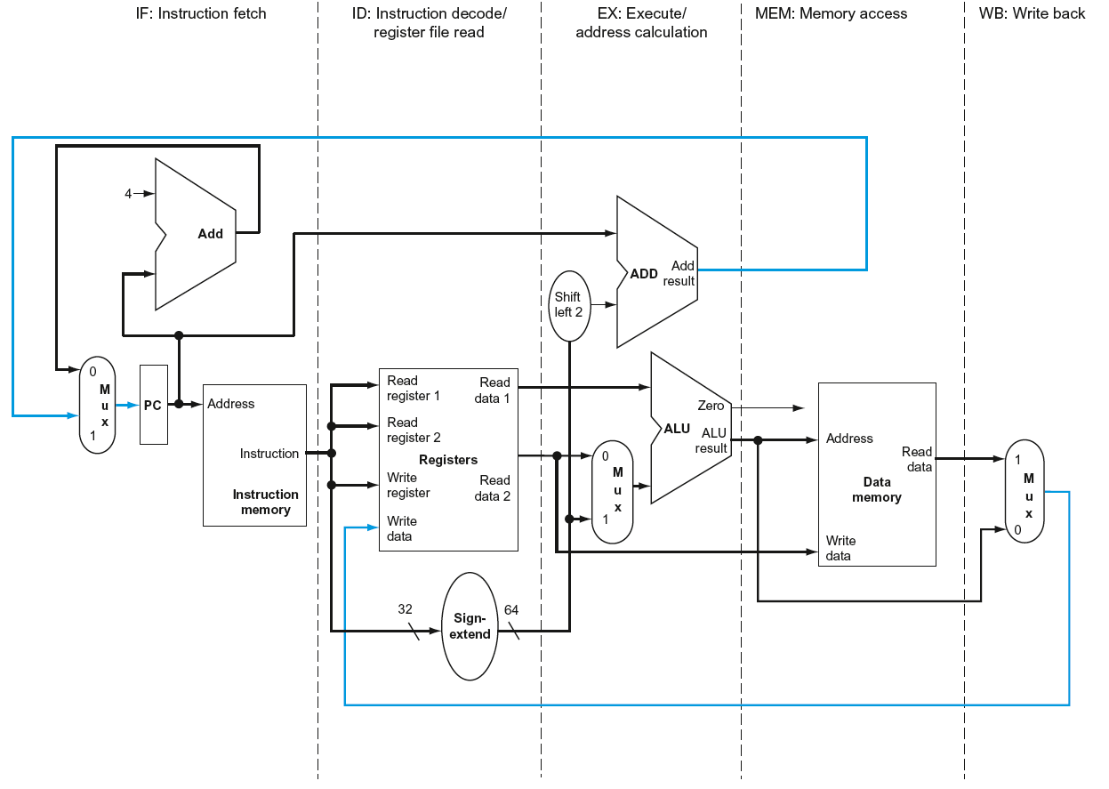
Pipeline Datapaths (slightly modified)

Slide 9
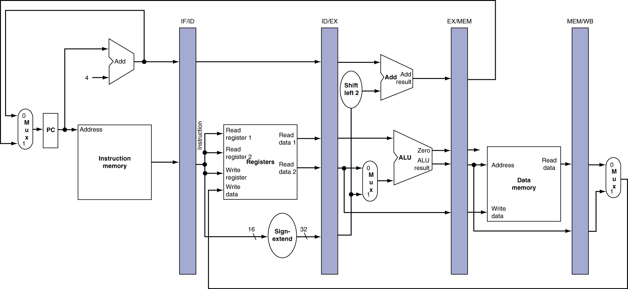
Need registers (or buffers) between stages
To hold information produced in previous cycle (including control signals)

Slide 10
Pipeline Datapaths
Tracks instruction completed EX
Tracks instruction completed EX or Mem
Tracks instruction fetched
Tracks instruction decoded

Slide 11
Pipeline Datapaths Data passed between stages
IF/ID:
Instruction: Since the opcode is needed in decode and execute stages;
Operands: Needed in decode, execute and write back stages.
PC: Decode and execute stage since a branch instruction may change the flow
ID/EX:
Register operands values read in Decode to Execute stage;
Destination register number and Opcode for Execute, MEM or WB stage
Control signals generated using opcode to other stages
EX/MEM:
Result of ALU operation either for WB or memory access.
Destination register number and opcode for MEM and WB stages
MEM/WB:
ALU result or value read from memory to WB
Destination register number (and opcode to determine if WB needs to write a result or not

Slide 12
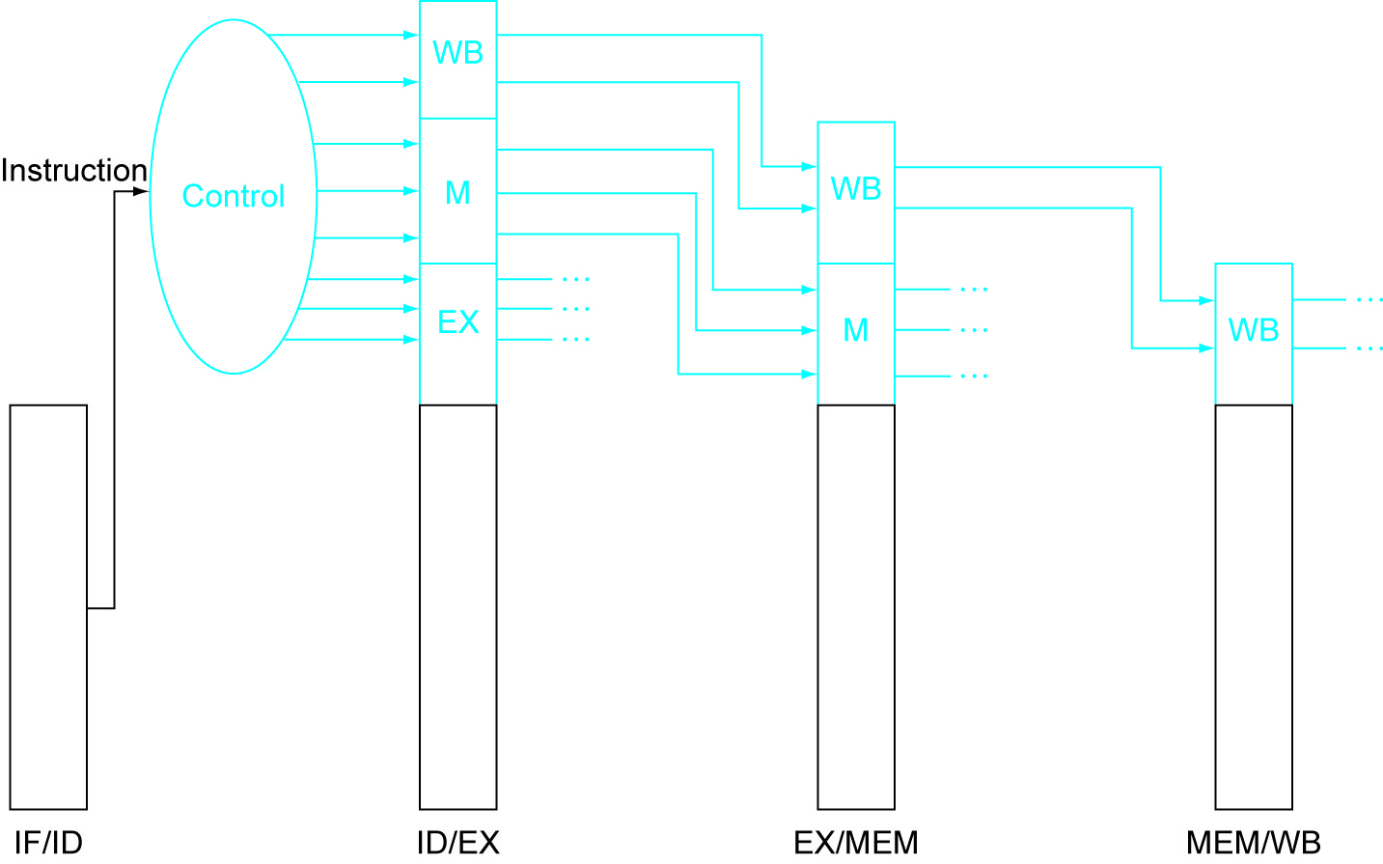

Slide 13
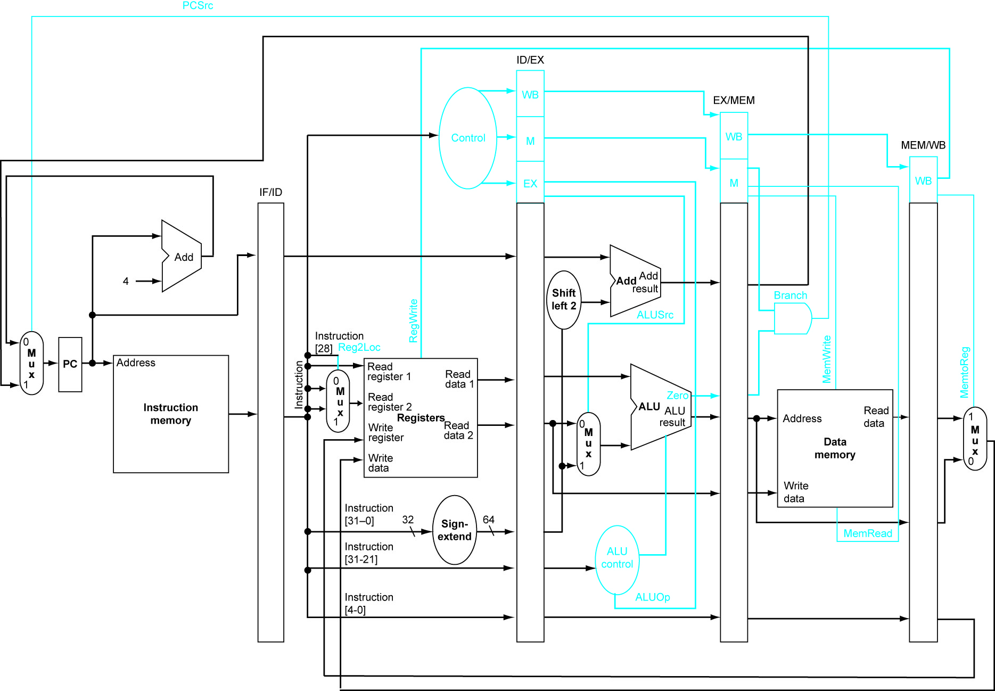

Slide 14
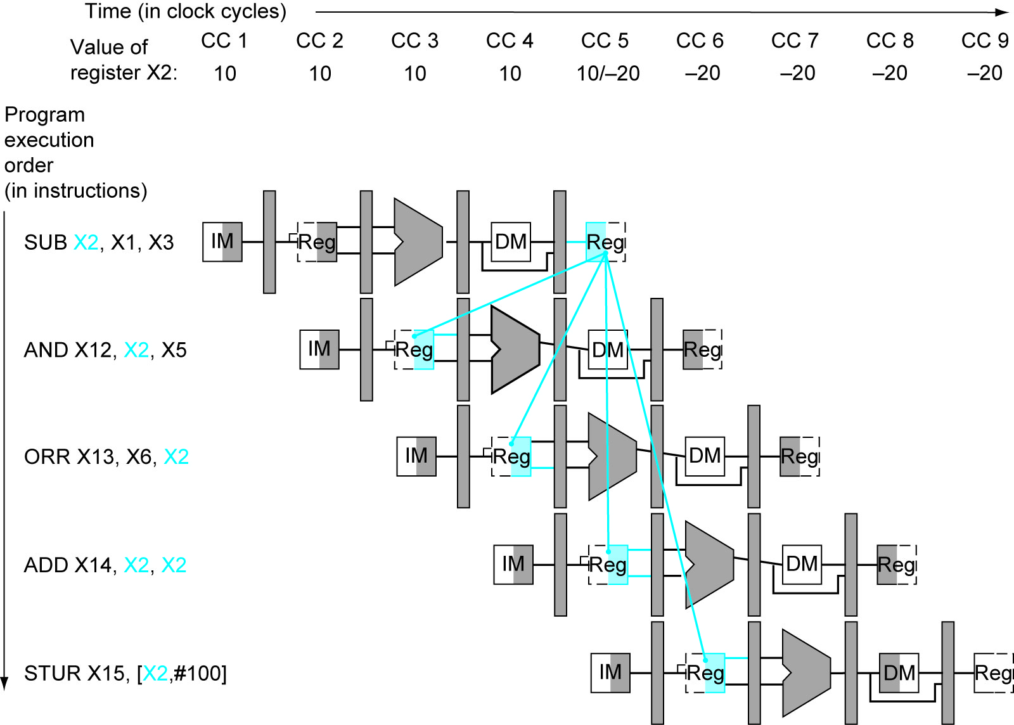

Slide 15
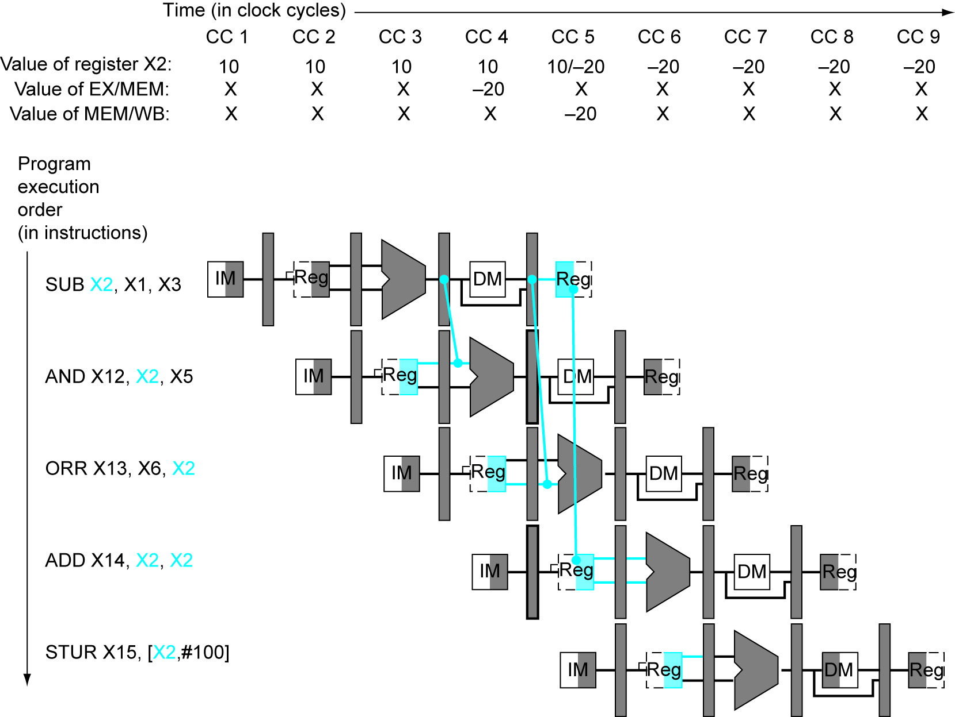

Slide 16
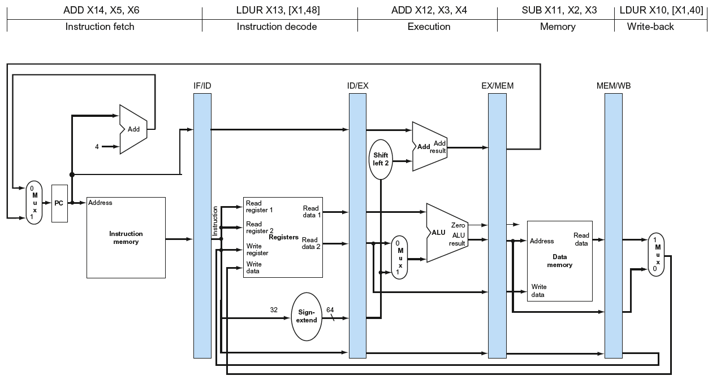
Yet another view of pipeline
State of the pipeline at clock cycle 5 → snapshot of the pipeline stages on a specific clock cycle
X1
X3
X4
[X1, 40]
X13
[PC] ->
1OOO1O11OOO OO1O1 OOOOOO OO11O O111O
(X2-X3)
#48
X13
X12
X11
X10

Slide 17
Yet another view of pipeline
State of the pipeline at clock cycle 5 → snapshot of the pipeline stages on a specific clock cycle
X5
X1
X6
X14
#48
(X2-X3)
(X3+X4)
X14
X13
X12
X11

Slide 18
Yet another view of pipeline
State of the pipeline at clock cycle 5 → snapshot of the pipeline stages on a specific clock cycle
X5
[X1, #48]
X6
X3+X4
X14
X13
X12

Slide 19
Yet another view of pipeline
State of the pipeline at clock cycle 5 → snapshot of the pipeline stages on a specific clock cycle
[X1, #48]
X5+X6
X14
X13

Slide 20
Yet another view of pipeline
State of the pipeline at clock cycle 5 → snapshot of the pipeline stages on a specific clock cycle
X5+X6
X14

Slide 21
Limitations to pipeline performance
In the ideal case, with 5 stage pipeline (as we have seen) we should get 5 times the speedup compared to un-pipelined computer
→because 5 instructions are being executed
But we do not always get this performance– Why?
Hazards
Situations that prevent starting next instruction in the next cycle
Structure hazards
A required resource is busy (what if we only had one type of memory?)
Data hazard
Need to wait for previous instruction to complete its data read/write
Control hazard
Deciding on control action depends on previous instruction
For conditional branch – what is the next instruction to fetch?

